Slide 1
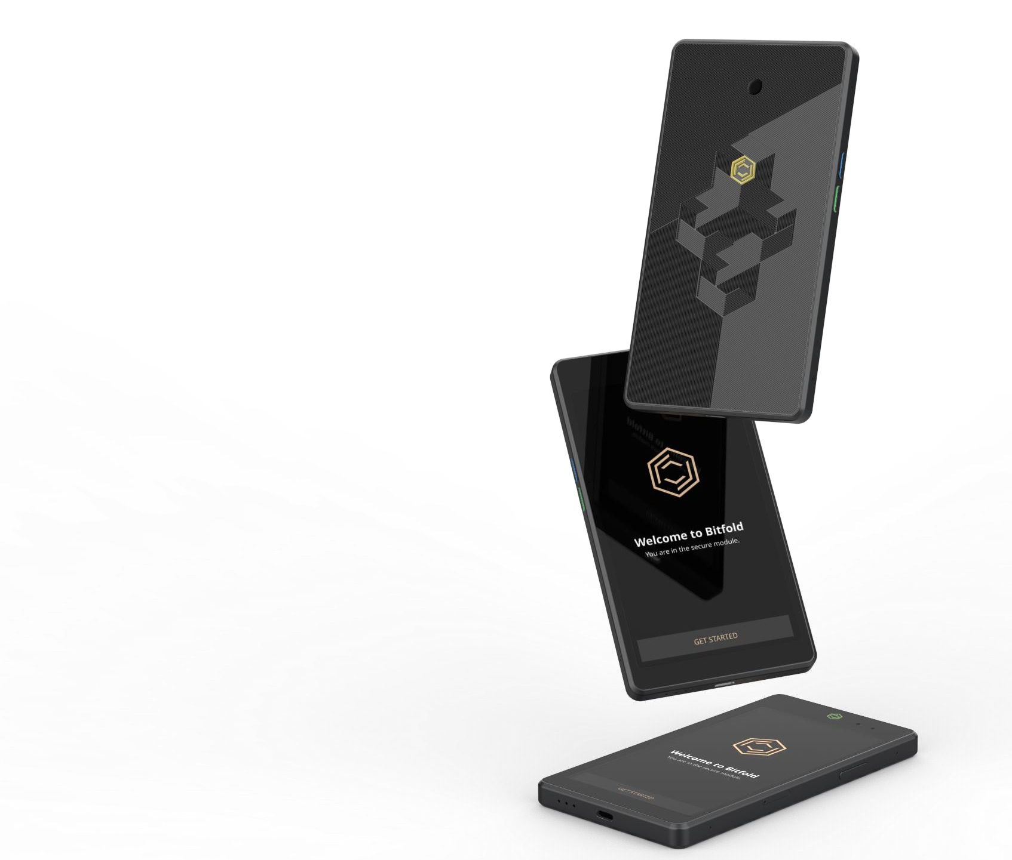

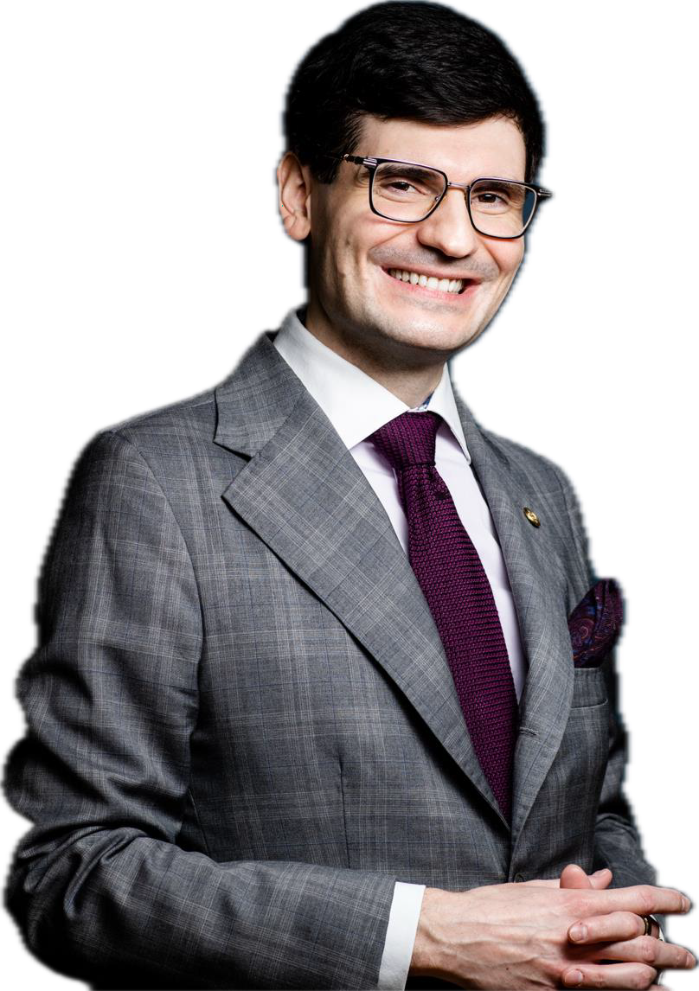
Security. Convenience. Trust.
Kamil Rafał Gancarz
Founder, President of the Board Bitfold AG

Slide 2
LEGAL NOTICE
THIS MATERIAL HAS BEEN PREPARED BY BITFOLD AG WITH ITS REGISTERED OFFICE IN SWITZERLAND, MÜHLEGASSE 18, 6340 BAAR, CANTON OF ZUG, IDENTIFICATION NUMBER CHE-266.860.023 (HEREINAFTER: THE COMPANY). SOME OF THE INFORMATION CONTAINED IN THIS MATERIAL RELATES TO THE FUTURE. THIS APPLIES IN PARTICULAR TO INFORMATION REGARDING STRATEGY, BUSINESS DEVELOPMENT, MARKET FORECASTS, PLANNED INVESTMENT OUTLAYS, FUTURE REVENUES OR COSTS. THIS INFORMATION SHOULD BE CONSIDERED ONLY AS PREDICTIONS THAT INVOLVE RISKS AND UNCERTAINTIES, AND THERE CAN BE NO ASSURANCE THAT THESE PREDICTIONS WILL BE ACHIEVED. THE BITFOLD HARDWARE WALLET IS A DEVICE UNDER DEVELOPMENT, THEREFORE SOME OF THE PRESENTED FEATURES AND FUNCTIONALITIES ARE NOT YET AVAILABLE AND MAY CHANGE. THE APPEARANCE OF THE DEVICE IS AN EXAMPLE AND MAY CHANGE. THE PRESENTED MATERIALS AND THE ENTIRE CONTENT OF THE BITFOLD AG WEBSITE www.bitfold.com ARE PROTECTED BY THE INTELLECTUAL PROPERTY RIGHTS.

Slide 3

O U R M I S S I O N
Our mission is to bring people more freedom and truth by making
blockchain and cryptography easy to use and extremely secure.
We create a solid foundation to a new reality by building a next generation hardware wallet that will unleash the true potential of digital space, serving as a seamless interface for Web 3.0.

Slide 4
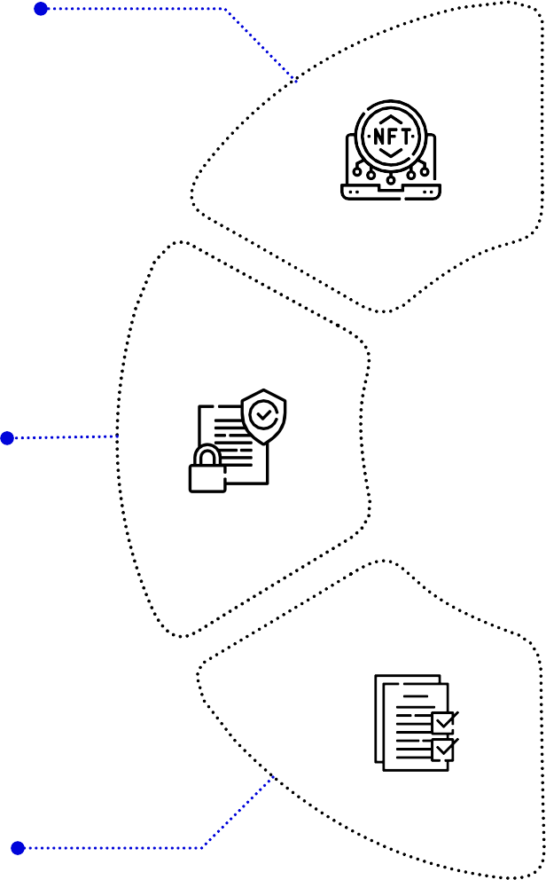
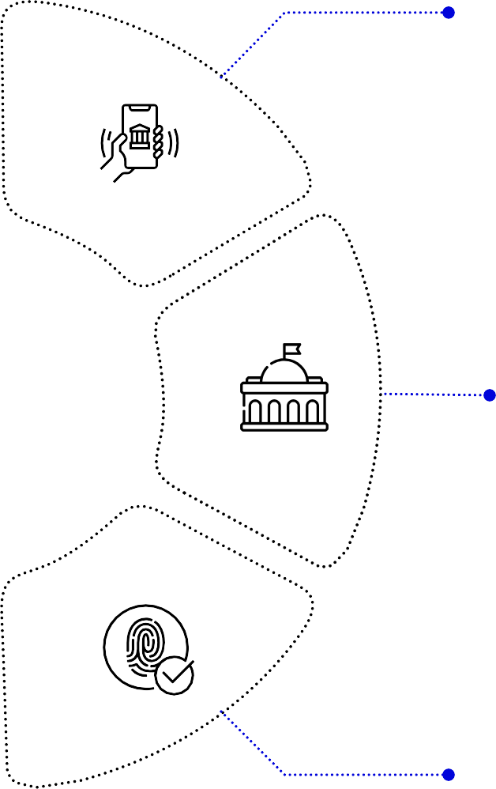

One device to secure them all!
Crypto and NFTs
Banking
Sensitive data, passwords, credentials
Governmental
services
Signing documents
Login authorisation
4

Slide 5


Problem
Solution
BITFOLD – personal security device for digital assets and authentication
Lack of security
ByBit, a leading cryptocurrency exchange, was the victim of a massive hack, resulting in the theft of $1.46 billion in cryptocurrency.
All existing software and hardware solutions are hackable
Difficulties using current hardware wallets
Reguired connection to a computer or smartphone
Unfliendly, unintuitive interface
Highest security
full isolation of private keys (virtual airgap) allowing for external communication (Bluetooth, WiFi, LTE, NFC) at the same time
Best user experience
First standalone (Internet-connected) hardware wallet, which allows the user to execute transactions in seconds instead of minutes. It is based on our tailor-made operating system BitfoldOS that provides user with seamless experience and clarity
Unlimited use cases
Bitfold use cases are endless. We are going to build marketplace of different applications on top of BitfoldOS and release SDK for developers
Limited to crypto
Storage and transactions of cryptocurrencies, not data
Limited hardware and software capabilities of existing wallets

Slide 6
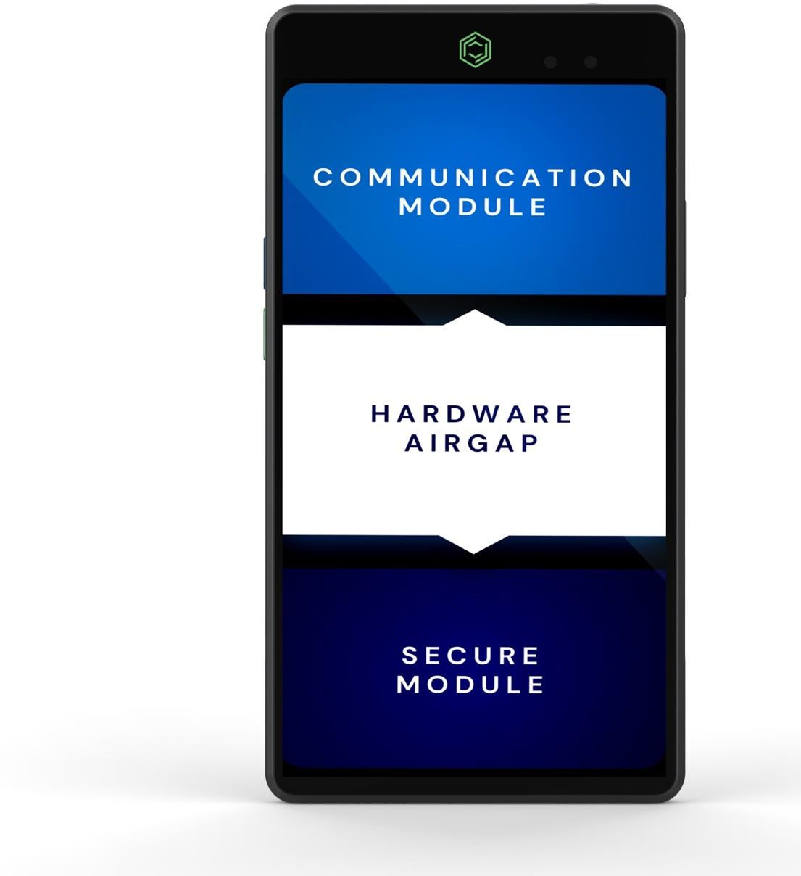

Next generation security standard
3 INDEPENDENT MODULES IN ONE DEVICE
Connected to the Internet, Applications, Broadcasting transactions
Important: Private keys are never exposed to external communication and yet BITFOLD is standalone
“Bridge module” (hardware airgap), responsible for transferring transactions and separates 1st and 3rd module
Keeps the private keys secure and allows for signing transactions

Slide 7
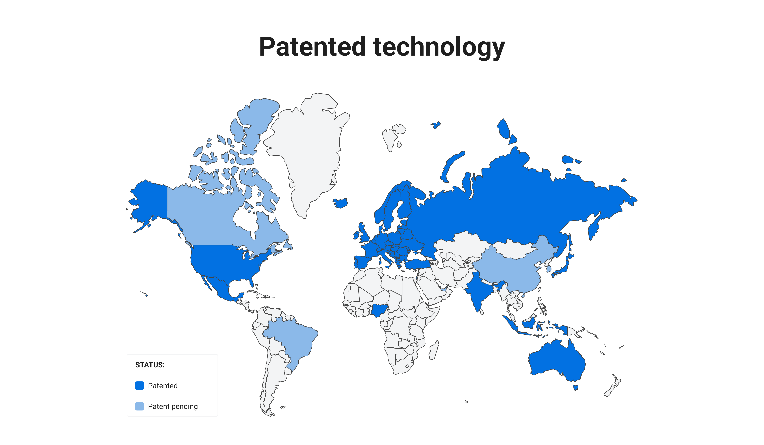

Slide 8
Competitive landscape
 | Hardware (cold) wallets | Software wallets (hot) | Phones | BITFOLD
Security | High | Low | Medium | Very high
Standalone | Requires connection to vulnerable device (laptop, phone) | Requires hardware | Requires chosen software wallet | Completely independent
Ease and speed of use | Hard (requires second device), slow | Fast and easy | Fast and easy | Dedicated, efficient, and fast mobile operating system- BitfoldOS
Interface | Small screen with tiny buttons or Touchscreen + External device | External device | Touchscreen | 5”5 Touchscreen
Use cases | Safety deposit box/ Transaction/ Authorization | Safety deposit box/ Transaction/ Verification | Safety deposit box/ Transaction/ Verification/ Authorization | Safety deposit box/ Transaction/ Verification/ Authorization

Slide 9
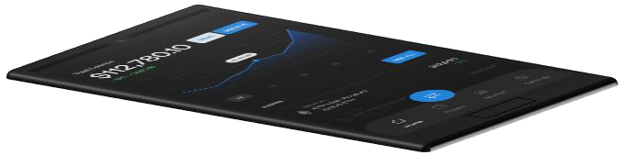
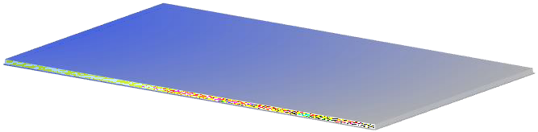


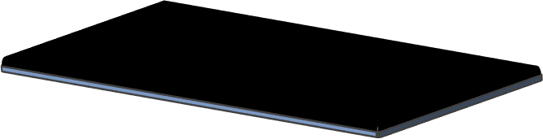
Our Technologies
Full hardware isolation of cryptographic keys
Protection against tampering (digital DNA, PUF)
Maintaining software integrity (Trust Zones, BIST)
Panic button (possibility to erase in case of danger)
Enhanced source of entropy
Dedicated BitoldOS system
IP65 certificate

Slide 10
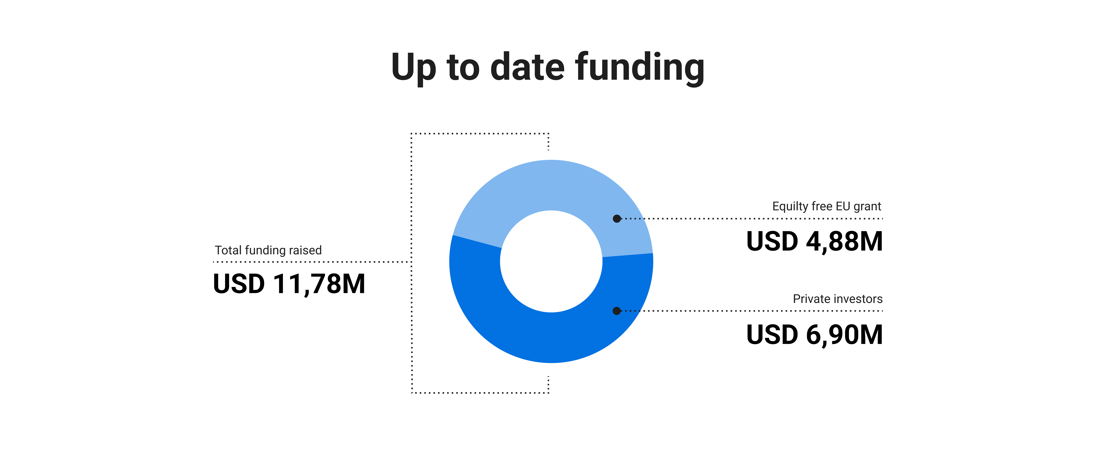
*NCBiR – funds obtained by Bitfold AG's subsidiary, i.e. Bitfold R&D sp. z o o. (as of November 30, 2023) as part of the company's research and development project entitled: "Bitfold - an innovative hardware wallet for private keys in blockchain technology and other applications of asymmetric cryptography", co-financed by the National Center for Research and Development (NCBiR) ) under the contract number: POIR.01.01.01-00-1101/20-00.
**PRIVATE INVESTORS – funds obtained from private investors as part of the increase in the share capital of Bitfold AG and the acquisition of new issue shares or the sale of Bitfold AG shares by its shareholder, i.e. the "BLOCKCHAIN DEVELOPMENT FOUNDATION" based in Łódź, intended for the development of the Bitfold project.

Slide 11
Market overview and trends
2030
TAM - Global crypto wallets market size
Grows at CAGR 22%
TAM
USD 138,1B
SAM - Hardware wallets market size
Grows at CAGR of 34%
SAM
USD 37,95B
SOM - Market opportunity (only device)
2025: Pre-sale of the device in form of token offering USD 120M
2030: Sales 700k units, revenue USD 1,470.6M
SOM USD 4,31B
Source: 1. Bitfold hardware wallet market sizing and pricing by GoGlobal partners 2. futuremarketinsights.com 3. statista.com
11

Slide 12




Our plans – business model expansion
Bitfold will be a platform for digital value
In addition to selling the device, we plan to:
Provide proprietary freemium services
Enable the integration of third-party applications and services available in our app store
Integrate investment platforms
Each of these paths will serve as an additional, recurring source of revenue.
This material has been prepared by Bitfold AG and is for informational, promotional or advertising purposes only. The document does not contain a recommendation to purchase shares of Bitfold AG, it is not investment, legal or tax advice or an indication that any investment or strategy is appropriate in the Investor's individual situation. The descriptions presented in this document do not constitute an offer within the meaning of Art. 66 of the Civil Code. Some information contained in this material relates to the future (including information regarding strategy, business development, market forecasts, planned capital expenditures, future revenues or costs). This information should be considered only as predictions that involve risks and uncertainties, and there can be no assurance that these predictions will be achieved. The BITFOLD hardware wallet is a device under development, so some of the features and functionalities presented in this material are not yet available and may change. The appearance of the device is an example and may change. The content presented in this document is the property of the Company.
Notes:
TBC

Slide 13




MILESTONES
Secure funding
Token offering, sales strategy and distribution channels setup, pre-sales of the device, first series (100 units), technology developement, device certification
Scaling
Aquiring new markets, work on additional products, scaling production facilities, further partnerships
2024
2025
2026
2027
2028
MVP
Worldwide patents granted (US and EU (and others), raised USD 9,5M funding, completion of EU equity- free project
Product launch
Break event point, shipping of up to 10 000 units in H1, further sales of the device, mass production start
Public listing
Target valuation of USD 6,7 bn
*Bitfold R&D sp. z o.o. with seats in Lodz r. finalized project co-financing by the European Union from the European Regional Development Fund under the Smart Growth Operational Programme 2014-2020 agreement: No. POIR.01.01.01-00-1101 / 20-00 of December 23, 2020. Bitfold AG is Bitfold R&D sp. z o.o. 100 % partner.
11

Slide 14
Financials – overview in millions USD
 | Pessimistic
Year | 2025 | 2026 | 2027 | 2028 | 2029 | 2030
Devices sold (units) | 5 000 | 16 500 | 33 000 | 66 000 | 100 000 | 130 000
Costs | $9,55 M | $13,23 M | $19,73 M | $30,82 M | $40,97 M | $49,76 M
Revenues | $4,2 M | $27,73 M | $55,46 M | $110,92 M | $168,07 M | $218,49 M
Net Profit |  |  | $5,2 M | $19,3 M | $33,9 M | $46,98 M
P/E ratio |  |  |  | 35
Forecasted valuation |  |  |  | $675,48 M | $1 186,5 M | $1 644,33 M
 | Optimal
Devices sold | 10 000 | 32 000 | 96 000 | 144 000 | 240 000 | 300 000
Costs | $18,55 M | $47,15 M | $125,53 M | $185,51 M | $305,11 M | $378,72 M
Revenues | $8,4 M | $53,78 M | $161,35 M | $242,02 M | $443,7 M | $554,62 M
Net Profit |  | $5,17 | $30,79 M | $49,35 M | $110,52 M | $140,35 M
P/E ratio |  |  |  | 35
Forecasted valuation |  |  |  | $1 727,29 M | $3 868,18 M | $4 912,21 M
 | Optimistic
Devices sold | 10 000 | 32 000 | 96 000 | 300 000 | 500 000 | 700 000
Costs | $24,00 M | $47,15 M | $125,53 M | $391,99 M | $643,73 M | $843,73 M
Revenues | $8,4 M | $53,78 M | $161,35 M | $630,25 M | $1 050,42 M | $1 470,59 M
Net Profit |  | $5,17 | $30,79 M | $190,26 M | $324,98 M | $626,86 M
P/E ratio |  |  |  | 35
Forecasted valuation |  |  |  | $6 659,17 M | $11 374,33 M | $21 940,10 M

Slide 15
Financials – revenue projection in mln $
 |  | $0.00 | 2025 | 2026 | 2027 | 2028 | 2029 | 2030
 |  | Pessimistic | $ 4.20 | $ 27.73 | $ 55.46 | $ 110.92 | $ 168.07 | $ 218.49
 |  | Optimal | $ 8.40 | $ 53.78 | $ 161.34 | $ 242.02 | $ 443.70 | $ 554.62
 |  | Optimistic | $ 8.40 | $ 53.78 | $ 161.34 | $ 630.25 | $1 050.42 | $1 470.59

Slide 16
Financials – net profit projection in mln $
$700.00
$600.00
$500.00
$400.00
$300.00
$200.00
$100.00
$0.00
 | 2026 | 2027 | 2028 | 2029 | 2030
Pessimistic | $ 0.00 | $ 5.21 | $ 19.30 | $ 33.90 | $ 46.98
Optimal | $ 5.17 | $ 30.79 | $ 49.35 | $ 110.52 | $ 140.35
Optimistic | $ 5.17 | $ 30.79 | $ 190.26 | $ 324.98 | $ 626.86

Slide 17








Equity funding - 30M USD
Use of funds (in millions USD)
4%
4%
2%
Budget categories (in thousands USD) | Total | % of budget
Product development (R&D) | 8,15 | 26.60%
COGS (production & components) | 7,7 | 25.10%
Legal & Finance | 3,87 | 12.60%
Marketing & Business Development | 4,82 | 15.80%
Administrative Costs | 2,95 | 9.60%
Customer support | 1,22 | 4.00%
Reserve | 1,28 | 4.20%
Total | 30 | 100.00%
10%
26%
16%
25%
13%
Product development (R&D) Legal & Finance Headquarters
Customer support
COGS (production & components) Marketing & Business Development Token program (without marketing) Reserve

Slide 18
Token programme spendings – 120M USD
Budget categories (in thousands USD) | Total | % of budget
Product development (R&D) | 7,2 | 6%
COGS (production & components) | 36 | 30%
Legal & Finance | 1,2 | 1%
Marketing & Business Development | 18 | 15%
Administrative Costs | 3,6 | 3%
Customer support | 6 | 5%
Trading, Token Buyback, Aquisitions | 30 | 25%
Overall NASDAQ listing preparation costs | 12 | 10%
Ecosystem Development & Community Growth | 6 | 5%
Total | 120 | 100%

Slide 19
Project Tokenization Goals
Capital Raise & Growth:
Secure funds for scaling device production, supporting continuous R&D efforts, and expanding our application ecosystem.
International Expansion & Strategic Acquisitions:
Facilitate global market entry and potential acquisitions to enhance our product and ecosystem offering.
Integrated Payment Ecosystem:
Establish a robust ecosystem with tokens as the primary payment method for device purchases, apps, services, and subscriptions.

Slide 20
Project Tokenization Goals
Flexible Device Sales Model:
Enable device sales through direct token payments and integrate seamless payment gateways supporting multiple currencies with settelment build on our token.
Deflationary Economic Model:
Introduce token scarcity by allocating a portion of tokens to treasury reserves, strengthening long-term token value.
Maintain Utility Token Nature:
Ensure the token's value remains driven by genuine use cases and market demand, explicitly avoiding security-like token features.

Slide 21
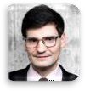
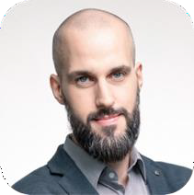
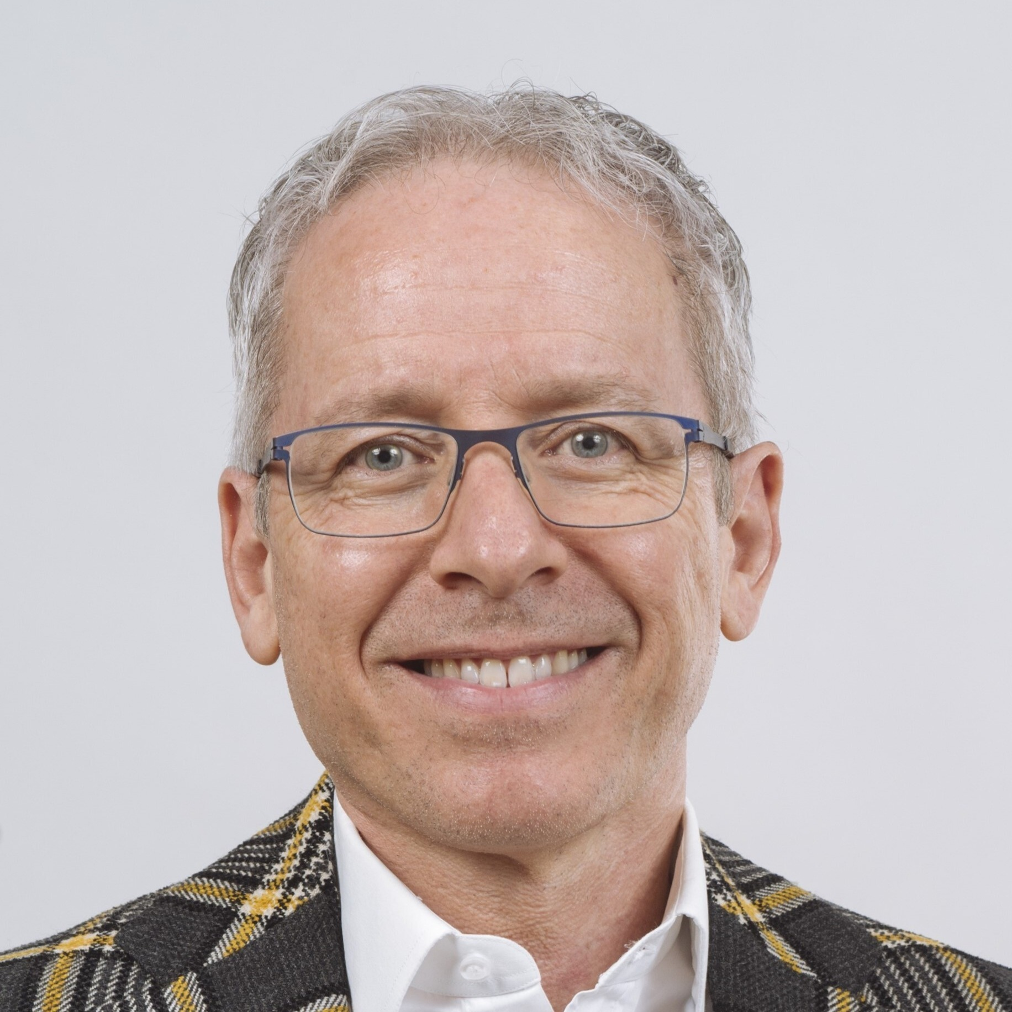
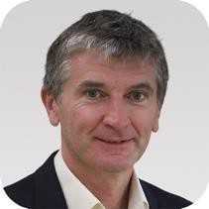
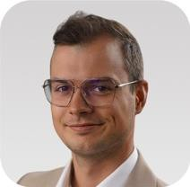
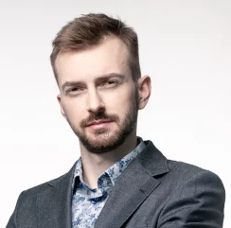
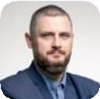
Key team members in Bitfold
Marcin Chojnacki
Senior hardware engineer Bitfold R&D
Mattia L. Rattaggi, PhD
Director and Advisor Bitfold AG
Kamil Gancarz
Founder, Inventorr, President of the board Bitfold AG
Inventor of Bitfold's core technology with 18 years in finance. Recognized crypto expert and trainer, MENSA member, financial consultant, and former trader with global financial institutions..
Engineer with in-depth knowledge of CAD/EDA tools, FPGA, image processing, PCB design, product development process and project management. At Bitfold R&D, he is involved in the design of hardware architecture, device miniaturisation, and thermal process optimisation.
Fintech & Web3 business developer. Advisor to digital finance and Web3 projects. Thought leader in blockchain, crypto finance, digital assets, AI. Education at University of Fribourg and University of Cambridge
Marcin Podgórski, PhD
Director of R&D Department Bitfold R&D
With extensive experience in delivering engineering solutions based on blockchain technology, he combines economic expertise with advanced technologies. He creates innovative projects by bridging the gap between economics and cutting-edge technology.
Rafał Kowalski
Chief Hardware Engineer
Rafał Kiełbus
Head of Blockchain Bitfold R&D
Cezary Reszel
Head of Business Development
A specialist in go-to-market strategy, building effective sales departments, and market strategies. He has over 10 years of experience in sales and managing IT projects, along with a deep understanding of technologies such as AI and blockchain
Electronic hardware engineer with over 9 years of experience. Designed hardware for inter alia fintech sector, Iot, digital imaging, digital audio, industrial. Have lot of experience with design high speed, high density, multi layer circuits boards for embedded systems. Co-author of several scientific publications.
Leading Blockchain expert in digital currencies, smart contracts, Lightning Network, and wallet security. Bitcoin Core contributor and board member of the Blockchain and New Technologies Chamber of Commerce.

Slide 22
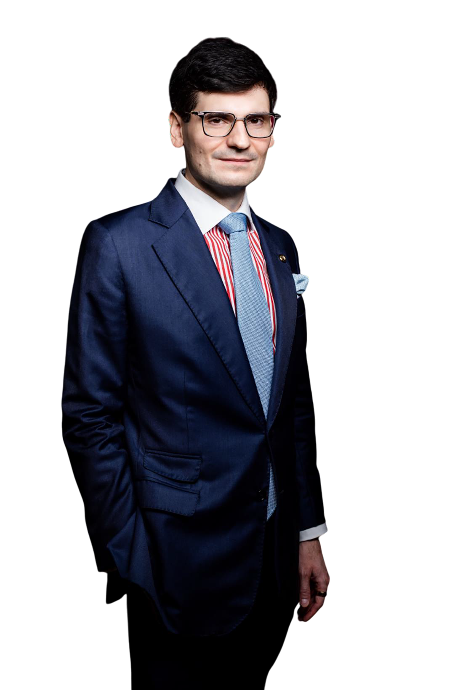
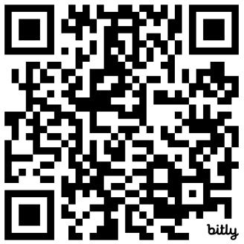
Thank you!
Kamil Rafał Gancarz
Founder, Inventor, President of the Board Bitfold AG
kamil@bitfold.com
https://www.bitfold.com

